Slide 1
Probability & Statistical Modelling
AQ077-3-2-PSMOD and Version VD1
Estimation and Confidence Interval

Slide 2
Topic & Structure of The Lesson
This topic is divided into 2 parts:
Part A: Sampling Distribution
Part B: Estimation & Confidence interval

Slide 3
Learning Outcomes
Part A: Sampling distribution:
At the end of this section, you should be able to:
Recognise what a sampling distribution is and how it differs from other types of probability distribution
Make statistical statements that rely upon knowledge of the central limit theorem.

Slide 4
Key Terms You Must Be Able To Use
If you have mastered this topic, you should be able to use the following terms correctly in your assignments and exams:
(Prepare your own list )
Mean
Proportion
Sample size
Central limit theorem
Confidence interval for population mean
Confidence interval for population proportion

Slide 5
Sampling Distribution
Introduction
Is the probability distribution of all possible sample means of n items drawn from a population.
Such a distribution exists not only for the mean but for any point estimate.
Properties
Very close to being normally distributed
The mean of the sampling is the same as the population mean.
It has a standard deviation which is called the standard error.

Slide 6
Standard Error
The standard deviation of the sampling distribution.
It measures the extent to which we expect the means from the different samples to vary because of the chance error in the sampling process.

Slide 7
Required to know how to:
Determine the standard error of the
mean
with finite population size
And known population standard deviation
And unknown population standard deviation
With infinite population size
And known population standard deviation
And unknown population standard deviation
Proportion
With finite population size
With infinite population size

Slide 8
Standard error of the | Population finite | Population infinite
Mean - Known population standard deviation - Unknown population standard deviation
Proportion

Slide 9
Central limit theorem
It states that as the sample size increases, the sampling distribution of the mean approaches the normal distribution in form, regardless of the form of the population distribution.
For practical purposes, the sampling distribution of the mean can be assumed to be approximately normal, regardless of the population distribution whenever the sample size is at least 30.

Slide 10
Statistical inference
Statistical inference can be defined as the process by which conclusions are drawn about some measure or attributes of a population based upon analysis of sample data.
Statistical inference can be divided into two types
Estimation
Hypothesis testing

Slide 11
Learning Outcomes
Part B: Estimation
At the end of this section, you should be able to:
Make a confidence interval estimate of a population mean.
Make a confidence interval estimate of a population proportion,
Determine the appropriate sample size for interval estimation of means and proportions.

Slide 12
Key Terms you must be able to use
If you have mastered this section, you should be able to use the following terms correctly in your assignments and exams:
(Prepare your own list)
Confidence interval
Level of significance
Sample size
Standard error.

Slide 13
Estimation
Introduction
Deals with the estimation of population characteristics from sample statistics
The distribution of sample means follows a normal curve.

Slide 14
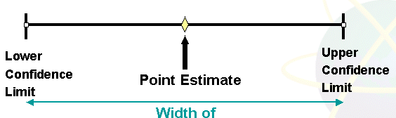
Point and Interval Estimates
A point estimate is a single number,
a confidence interval provides additional information about variability

Slide 15
Point Estimates
We can estimate a
Population Parameter …
with a Sample Statistic
(a Point Estimate)
Mean
μ
x
Proportion
p
p

Slide 16
How much uncertainty is associated with a point estimate of a population parameter?
An interval estimate provides more information about a population characteristic than does a point estimate
Such interval estimates are called confidence intervals

Slide 17
Confidence Interval Estimate
An interval gives a range of values:
Takes into consideration variation in sample statistics from sample to sample
Based on observation from 1 sample
Gives information about closeness to unknown population parameters
Stated in terms of level of confidence
Never 100% sure

Slide 18
Estimation Process
Random Sample
I am 95% confident that μ is between 40 & 60.
Population
Mean
x = 50
(mean, μ, is unknown)
Sample

Slide 19
The general formula for all confidence intervals is:
Point Estimate ± (Critical Value)(Standard Error)

Slide 20
Confidence Level
Confidence in which the interval will contain the unknown population parameter
A percentage (less than 100%)

Slide 21
Suppose confidence level = 95%
Also written (1 - α) = .95
A relative frequency interpretation:
In the long run, 95% of all the confidence intervals that can be constructed will contain the unknown true parameter
A specific interval either will contain or will not contain the true parameter
No probability involved in a specific interval

Slide 22
Confidence
Intervals
Population
Mean
Population
Proportion
σ Known
σ Unknown

Slide 23
Confidence interval for μ (σ known)
Assumptions
Population standard deviation σ is known
Population is normally distributed
If population is not normal, use large sample
Confidence interval estimate

Slide 24
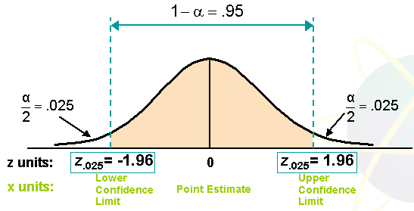
Finding the critical value
Consider a 95% confidence interval:

Slide 25
Commonly used confidence levels are 90%, 95%, and 99%
Confidence Level
Confidence Coefficient,
z value,
80%
90%
95%
98%
99%
99.8%
99.9%
.80
.90
.95
.98
.99
.998
.999
1.28
1.645
1.96
2.33
2.575
3.08
3.27

Slide 26
Margin of Error (e): the amount added and subtracted to the point estimate to form the confidence interval
Example: Margin of error for estimating μ, σ known:

Slide 27
Factors Affecting Margin of Error
Data variation, σ : e as σ
Sample size, n : e as n
Level of confidence, 1 - α : e if 1 - α

Slide 28
Quick Review Question
Example 5.1:
A sample of 11 circuits from a large normal population has a mean resistance of 2.20 ohms. We know from past testing that the population standard deviation is .35 ohms.
Determine a 95% confidence interval for the true mean resistance of the population.

Slide 29
95% confidence interval:

Slide 30
Interpretation
We are 95% confident that the true mean resistance is between 1.9932 and 2.4068 ohms
Although the true mean may or may not be in this interval, 95% of intervals formed in this manner will contain the true mean
An incorrect interpretation is that there is 95% probability that this interval contains the true population mean.
(This interval either does or does not contain the true mean, there is no probability for a single interval)

Slide 31
Example 2
After a particularly wet nights, 10 worms surfaced on the lawn. Their lengths, measured in cm, were
9.5 9.5 11.2 10.6 9.9 11.1 10.9
9.8 10.1 10.2
Assuming that this sample came from a normal population with variance 4, calculate a 95% confidence interval for the mean length of all the worms in the garden.

Slide 32
Confidence interval for μ (σ Unknown)
If the population standard deviation σ is unknown, we can substitute the sample standard deviation, s
This introduces extra uncertainty, since s is variable from sample to sample
So we use the t distribution instead of the normal distribution

Slide 33
Assumptions
Population standard deviation is unknown
Population is normally distributed
If population is not normal, use large sample
Use Student’s t Distribution
Confidence Interval Estimate

Slide 34
The t is a family of distributions
The t value depends on degrees of freedom (d.f.)
Number of observations that are free to vary after sample mean has been calculated
d.f. = n - 1

Slide 35
Quick Review Question
Example: Suppose the mean of 3 numbers is 8.0
Let x₁ = 7
Let x₂ = 8
What is x₃?
If the mean of these three values is 8.0,
then x₃ must be 9
(i.e., x₃ is not free to vary)
Here, n = 3, so degrees of freedom = n -1 = 3 – 1 = 2
(2 values can be any numbers, but the third is not free to vary for a given mean)

Slide 36
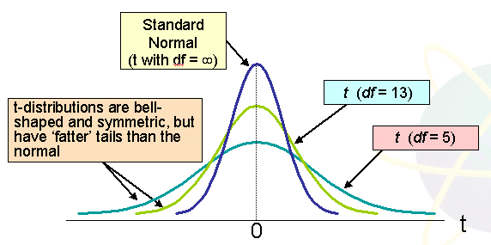
Student’s t-distribution
Note: t z as n increases

Slide 37
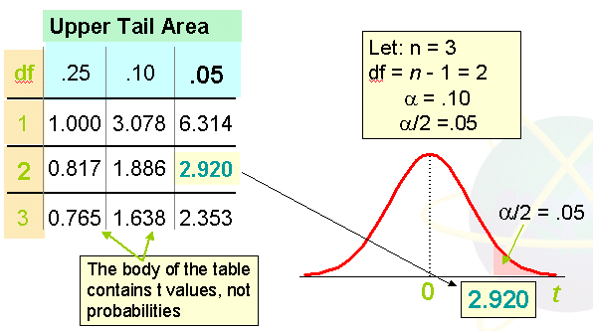
Student’s t - table

Slide 38
t – distribution with comparison to the z value
Confidence t t t z
Level (10 d.f.) (20 d.f.) (30 d.f.) ____
.80 1.372 1.325 1.310 1.28
.90 1.812 1.725 1.697 1.64
.95 2.228 2.086 2.042 1.96
.99 3.169 2.845 2.750 2.57
Note: t z as n increases

Slide 39
Example 3
A random sample of n = 25 has x = 50 and s = 8. Form a 95% confidence interval for μ

Slide 40
Approximation for Large samples
Since t approaches z as the sample size increases, an approximation is sometimes used when n ≥ 30:
Technically
correct
Approximation
for large n

Slide 41
Example 4
A random sample of 120 measurements taken from a normal population gave the following data:
n = 120, , s = 1.44
Find
(a) a 97% confidence interval
(b) a 99% confidence interval

Slide 42
Example 5
The 95% confidence interval for the mean paper length is (10.994 inches, 11.002 inches). This interval is based on results from a random sample of 100 sheets. Find the 99% confidence interval for the mean paper length, assuming that the paper length is normally distributed.

Slide 43
Determining Sample Size
The required sample size can be found to reach a desired margin of error (e) and level of confidence (1 - α)
Required sample size, σ known:

Slide 44
Example 6
Example:
If σ = 45, what sample size is needed to be 90% confident of being correct within ± 5?
So the required sample size is n = 220
(Always round up)

Slide 45
If σ is unknown
If unknown, σ can be estimated when using the required sample size formula
Use a value for σ that is expected to be at least as large as the true σ
Select a pilot sample and estimate σ with the sample standard deviation, s

Slide 46
Confidence
Intervals
Population
Mean
Population
Proportion
σ Known
σ Unknown

Slide 47
Confidence Intervals for the Population Proportion, p
An interval estimate for the population proportion ( p ) can be calculated by adding an allowance for uncertainty to the sample proportion ( p )

Slide 48
Recall that the distribution of the sample proportion is approximately normal if the sample size is large, with standard deviation
We will estimate this with sample data:

Slide 49
Confidence intervals endpoints
Upper and lower confidence limits for the population proportion are calculated with the formula
where
z is the standard normal value for the level of confidence desired
p is the sample proportion
n is the sample size

Slide 50
Example 7
Example:
A random sample of 100 people shows that 25 are left-handed.
Form a 95% confidence interval for the true proportion of left-handers

Slide 51
Interpretation
We are 95% confident that the true percentage of left-handers in the population is between 16.51% and 33.49%.
Although this range may or may not contain the true proportion, 95% of intervals formed from samples of size 100 in this manner will contain the true proportion.

Slide 52
Changing the sample size
Increases in the sample size reduce the width of the confidence interval.
Example:
If the sample size in the above example is doubled to 200, and if 50 are left-handed in the sample, then the interval is still centered at .25, but the width shrinks to
.19 …… .31

Slide 53
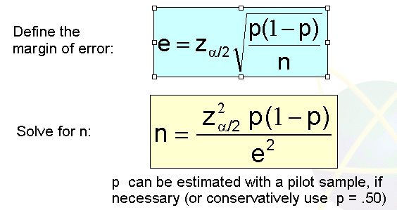
Finding the required sample size for proportion problems

Slide 54
Example 8
What Sample size ?
How large a sample would be necessary to estimate the true proportion defective in a large population within 3%, with 95% confidence?
(Assume a pilot sample yields p = .12)

Slide 55
For 95% confidence, use Z = 1.96
E = .03
p = .12, so use this to estimate p

Slide 56
Summary of Main Teaching Points
Estimation on population mean and proportion
Confidence interval on population mean and proportion

Slide 57
Question and Answer Session
Q & A

Slide 58
What we will cover next
Hypothesis Testing

